Slide 1
How to answer the ‘affect’ questions
By the end of the session I will feel confident on knowing how to recognise what the examiners want from my answers.

Slide 2
The use of affect…
Explain how the building of the supermarket may affect the people of Whitby. [4]
Candidate A: The supermarket will affect journey times because of all the extra traffic. It will affect the elderly because they will be able to get to the supermarket easily.
What is wrong with this answer? Give it an EBI

Slide 3
The use of affect…
Explain how the building of the supermarket may affect the people of Whitby. [4]
Candidate A: The supermarket will affect journey times because of all the extra traffic. It will affect the elderly because they will be able to get to the supermarket easily.
The candidate thought that they had explained that the extra traffic will impact on journey times but they haven’t said whether journey times will be longer or shorter. It is not the job of the examiner to interpret meaning where it is implied.
The second point does not say how the elderly are affected.

Slide 4
What the candidate should have written was:
There will be extra traffic so journey times will be longer. The elderly will find it easy to access the supermarket because it is closer to their homes.
Never, EVER, EVER use the word affect in your answer.

Slide 5
Mark these answers
Explain how the building of this supermarket may affect the people of Whitby. [4]
Candidate A
It will affect young people as it will give them jobs.
Candidate B
The local businesses such as the local fishermen will be affected since they won’t be able to compete with the large stores.
Candidate C
Local unemployed builders will be affected as they would need builders.

Slide 6
Mark these answers
Explain how the building of this supermarket may affect the people of Whitby. [4]
Candidate A
It will affect young people as it will give them jobs. (1 mark)
Candidate B
The local businesses such as the local fishermen will be affected since they won’t be able to compete with the large stores. (1 mark)
Candidate C
Local unemployed builders will be affected as they would need builders. (1 mark)

Slide 7
So how would you do it?
Explain how the building of this supermarket may affect the people of Whitby. [4]
 |  | Double your marks!
Candidate A | It will affect young people as it will give them jobs. (1 mark) | Young people will get jobs SO more money. (2 marks)
Candidate B | The local businesses such as the local fish shops will be affected since they won’t be able to compete with the large stores. (1 mark) | Local businesses such as fish shops will lose money BECAUSE they can’t compete with the large stores. (2 marks)
Candidate C | Local unemployed builders will be affected as they would need builders. (1 mark) | Local builders will get jobs and more money BECAUSE they need more builders. (2 marks)

Slide 8
How about this question
Candidate A
It would affect people’s health from dust created under construction. (L1 = simple explanation)
Candidate B
Locals will be affected by traffic. (1) (L1 = simple explanation)
Candidate C
There is a lot of woodland that would have to be cleared affecting the look of the area.(L1 = simple explanation)
Explain why some people may be against building affordable housing at the proposed site near Ruswarp. [5]

Slide 9
How about this question
 |  | Double your marks!
Candidate A | It would affect people’s health from dust created under construction. (L1) | The dust from the building could damage people’s health (e.g. Make asthmas worse) (level 2 = simple explanation)
Candidate B | Locals will be affected by traffic. (L1) | There will be more traffic so locals might have more traffic jams and longer journeys (level 2 = simple explanation)
Candidate C | There is a lot of woodland that would have to be cleared affecting the look of the area. (L1) | There is a lot of woodland that would have to be cleared and it would ruin the natural look of the landscape. (level 2 = simple explanation)
Explain why some people may be against building affordable housing at the proposed site near Ruswarp. [5]

Slide 10
Explaining your answers:
It has full education facilities
So workers will be trained/skilled to do the work.
It provides technical support
So businesses will not struggle/it will succeed
It has all infrastructure provided on site
So saves money when opening/setting up
It has over 120 IT companies
So can share skills /machines/ideas/ research and development
Max of 2 marks if no explanation

Slide 11
What about those case studies?
Explain
Describe
Name and Locate
To be successful at case studies you must do all 3!

Slide 12
This is how your case study is marked
Level and Mark | Criteria
Level 1 (1 or 2 marks) | Basic description AND/OR explanation.
Level 2 (3 or 4 marks) | Must have named a real case study. Some description AND/OR explanation.
Level 3 (5 or 6 marks) | Must have included description AND explanation. Must have elaborated description and explanation.
Level 4 (7 or 8 marks) | Excellent example with some detail. Wholly accurate – no duff information! Well elaborated description and explanation.

Slide 13
Mark this answer using the mark scheme
Dawlish Warren’s coastline is located in devon south west england, 20km away from exeter the main natural features would be the sand dunes and the sea this area is been managed sustainably by having groynes on the beach going into the sea to preven long shore drift, also they dont let dog walkers past a certain groyne so some of the beech is untouched, they also made part of Dawlsh warren Coastline in to a amusment area they did this because by destroying one are you protect others from being trampled and ruined,

Slide 14
How could they get full marks?
Name and locate
Does not need a lot of information –simple but VERY important.
Describe natural features
Describe rock type – even hard/soft would be better than ‘there are cliffs’
Explain how area is being managed sustainably
Could be environmental management e.g. Bins/footpaths, fencing to reduce impact of tourism. Or planting of marram grass to reduce sand dune erosion.
Because many coastlines have both headlands and bays it is important not to confuse hard and soft rock features.
Name any landform features e.g. Flamborough Head or Spurn Point spit
Excellent answers would include height of cliffs and vegetation type
Is the beach sandy or rocky?
Could be economic management e.g. Building of sea wall to protect tourism business or housing, building of groynes to build up beach and reduce erosion.

Slide 15
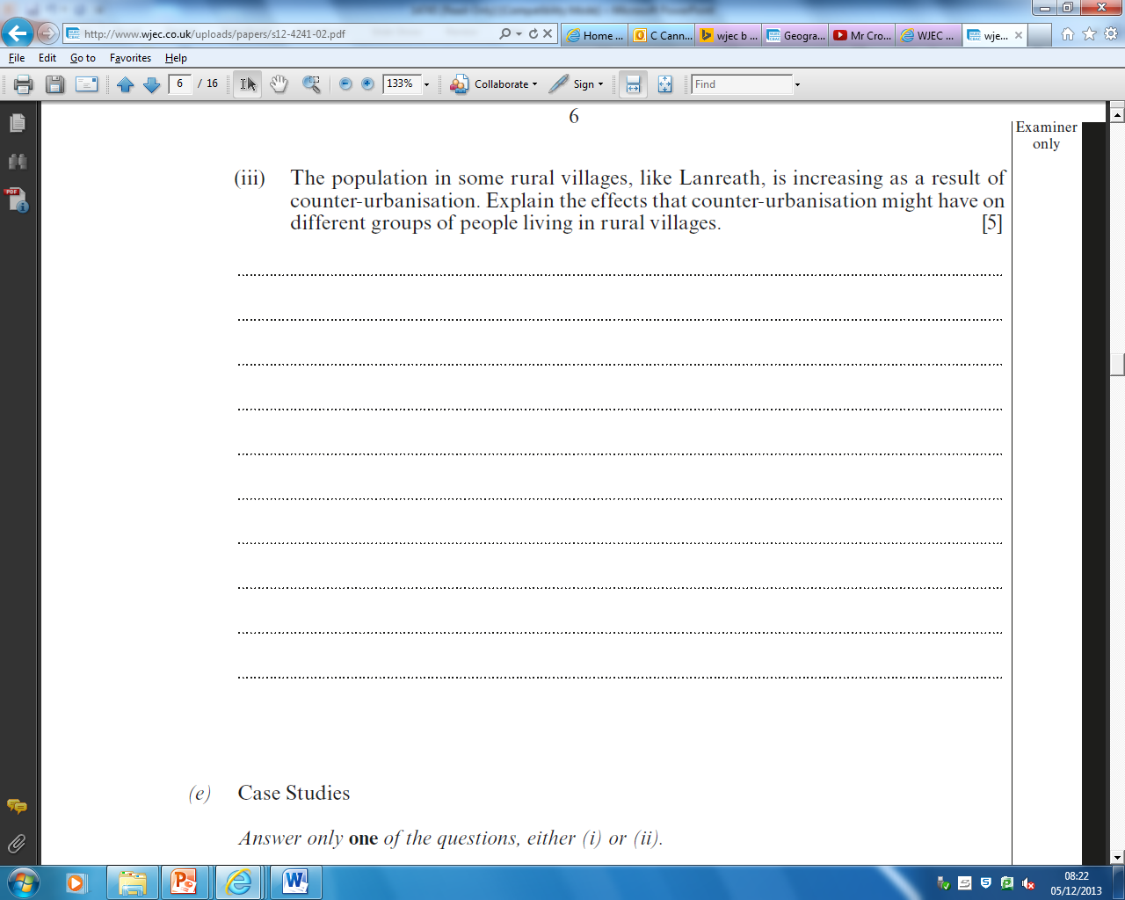
WJEC have been sneaky and they actually level you one question before the case study….

Slide 16
The mark scheme
Level 1 (1 mark) | Simple description
Level 2 (2 or 3 marks) | Simple Explanation
Level 3 (4 or 5 marks) | Detailed Explanation with information specific to question
In simple terms it means:
Well explained points
Some reference to the location named to get to level 3
Some reference specifically to the key words being used in the answer.

Slide 17
Mark this answer:
River Flooding is a major problem throughout the world. Describe and explain methods that could be used to prevent river flooding. [5]
Use dams to control the flow of the water. Build levees to increase the amount of water held in the river like on the Mississippi River. Plant trees to increase interception.

Slide 18
Mark this answer:
Examiner Comments:
3 explained ideas with an example of a River but only simple explanation.
Max Level 2.
Use dams to control the flow of the water. Build levees to increase the amount of water held in the river like on the Mississippi River. Plant trees to increase interception.

Slide 19
How could we make it better?
Use dams to control the flow of the water. Build levees to increase the amount of water held in the river like on the Mississippi River. Plant trees to increase interception.
Description | Explanation | Even Better If | Specific Example
Build a dam
Build levees

Slide 20
How could we make it better?
Use dams to control the flow of the water. Build levees to increase the amount of water held in the river like on the Mississippi River. Plant trees to increase interception.
Description | Explanation | Even Better If | Specific Example
Build a dam | To control the water flow | In times of heavy rainfall | Aswan Dam
Build levees | By increasing the height of the river banks e.g. With concrete or soil | To increase the channel capacity | On the Mississippi River

